Slide 1



FITBLAST
FITNESS
TRACKING APPLICATION
Raman Mendiratta 22CSU144
Akash Yadav 22CSU207
Tanay 22CSU222
Harshit Kalra 22CSU084
“
ACHIEVE PEAK FITNESS WITH FITBLAST

Slide 2

WHAT IS FITBLAST?
A web application to set workout preferences, track workouts, and engage socially.
Purpose:
Promote personalized fitness tracking and community interaction.

Slide 3

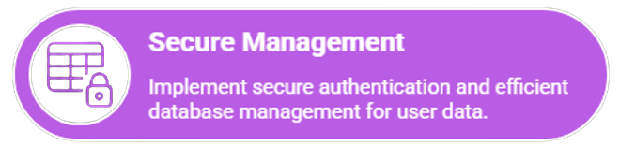
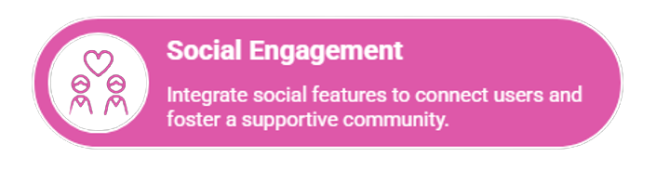
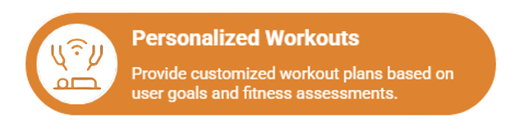
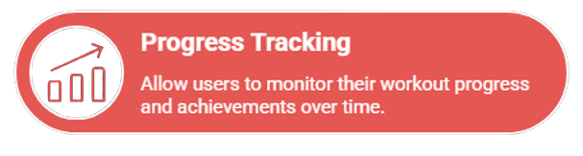
OBJECTIVES
Step into fitblast and start your journey to strength, health, and confidence!

Slide 4
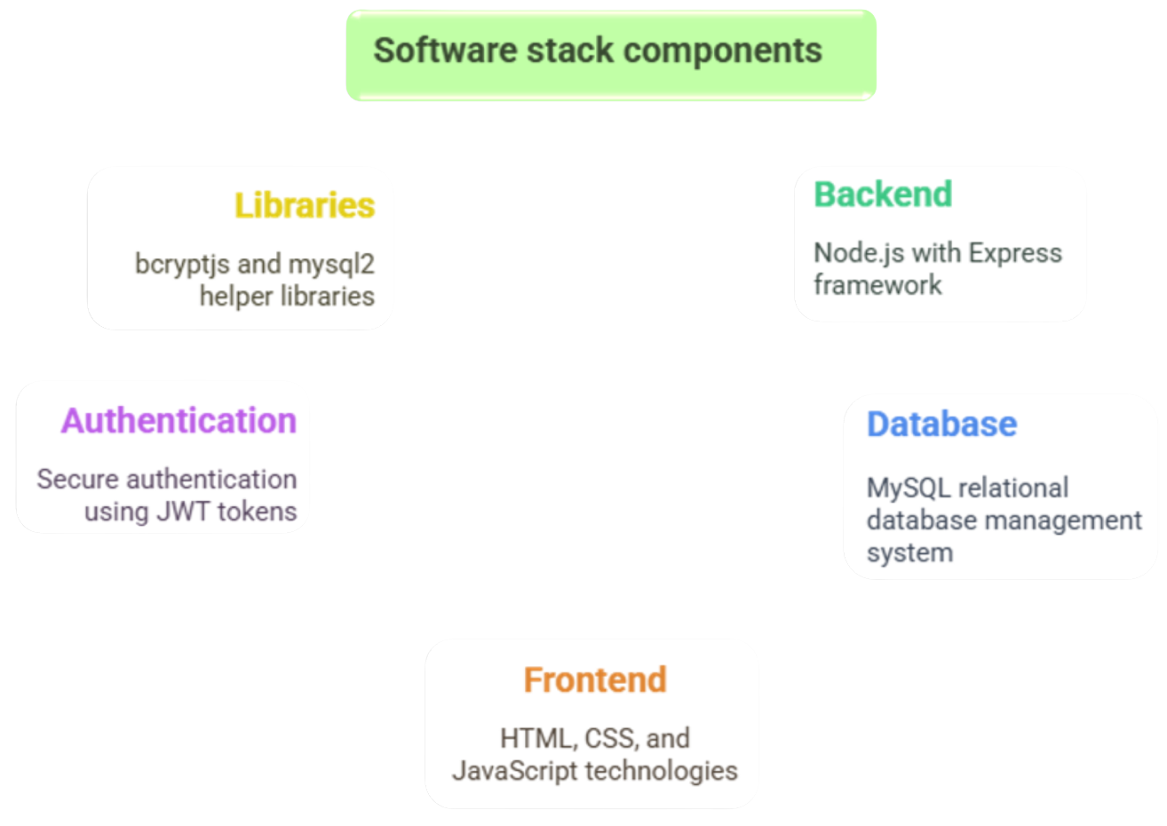


Slide 5
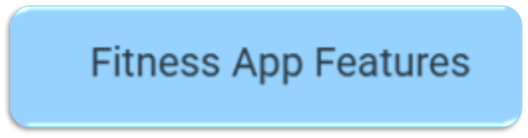
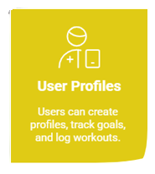
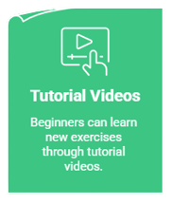

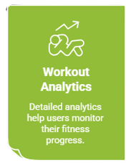
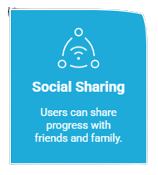
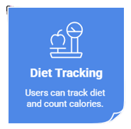

Slide 6
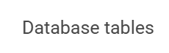
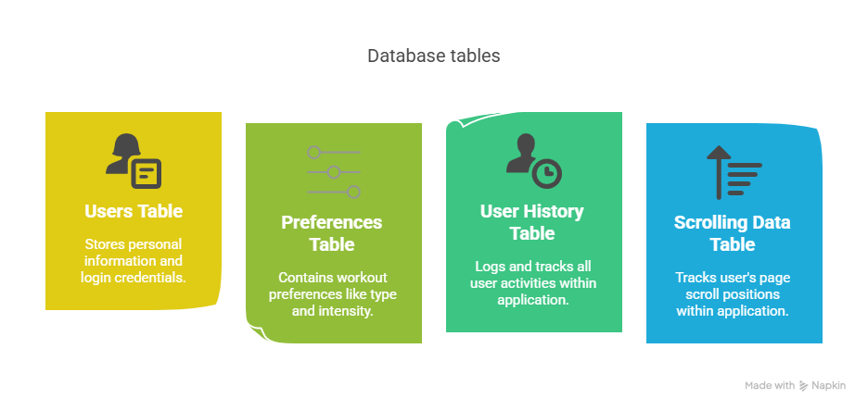

Slide 7
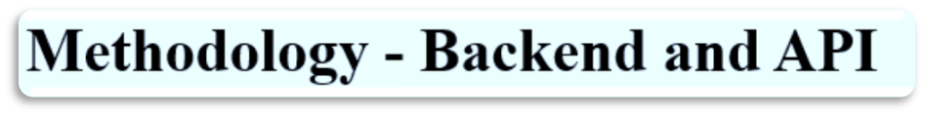
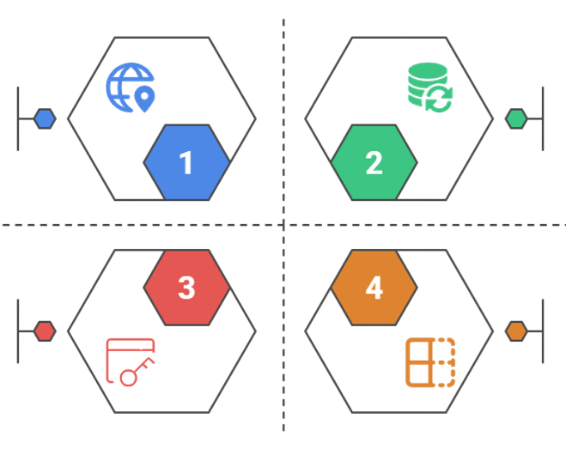
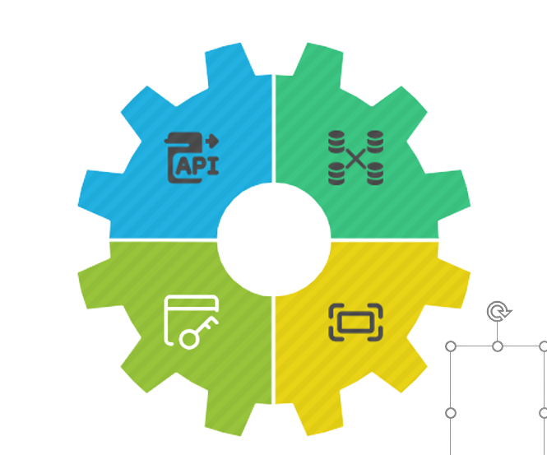
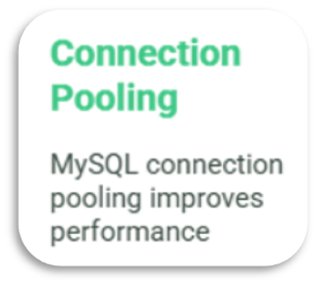
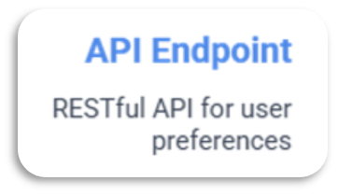

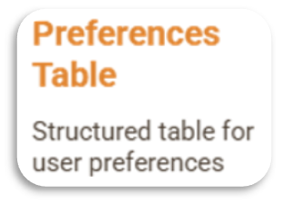

Slide 8
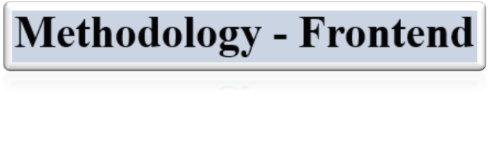
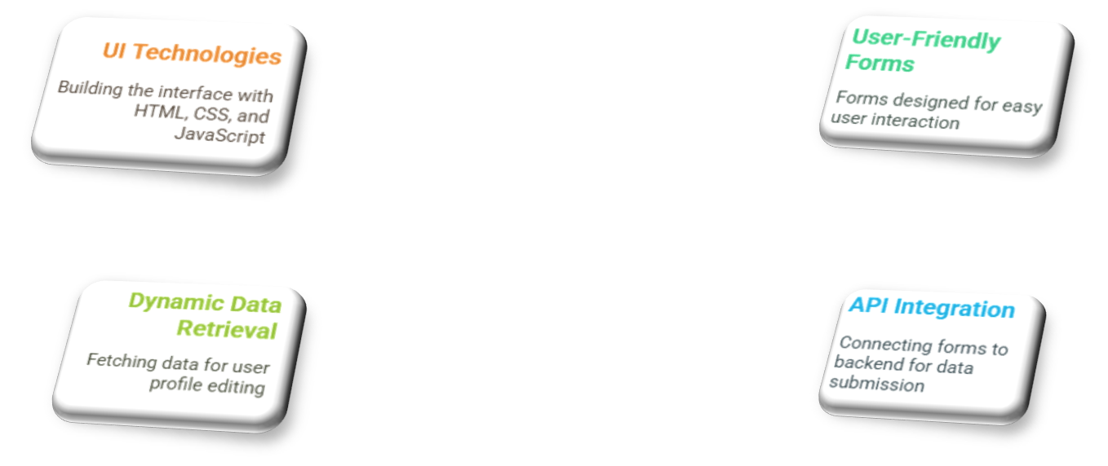
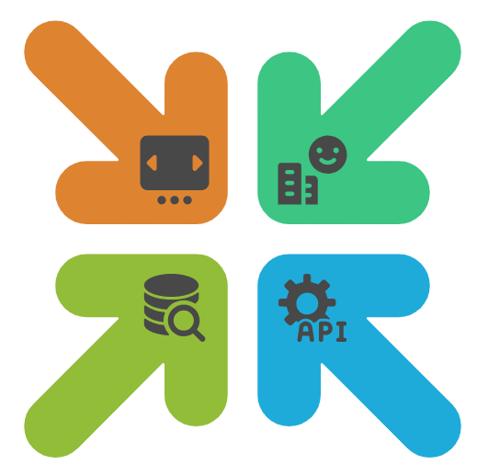

Slide 9
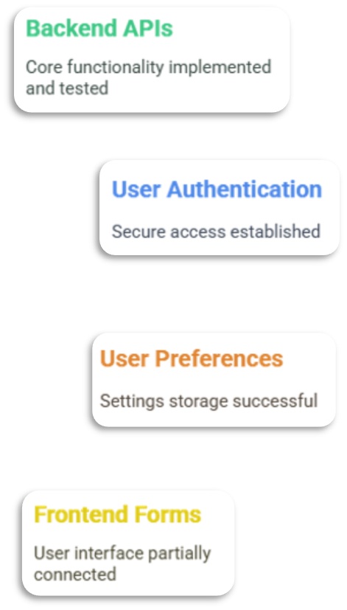
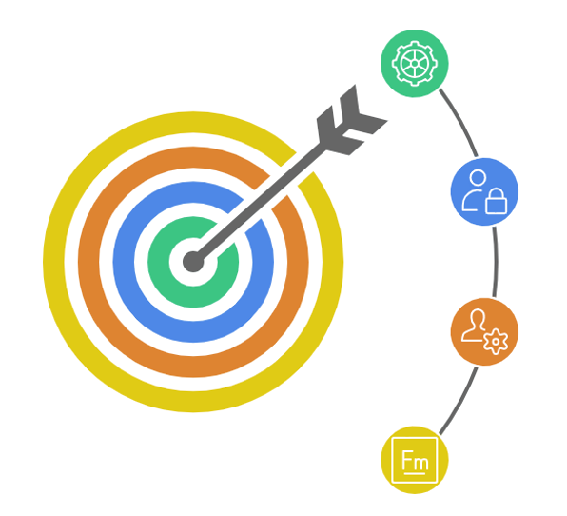
RESULTS
SO
FAR

Slide 10
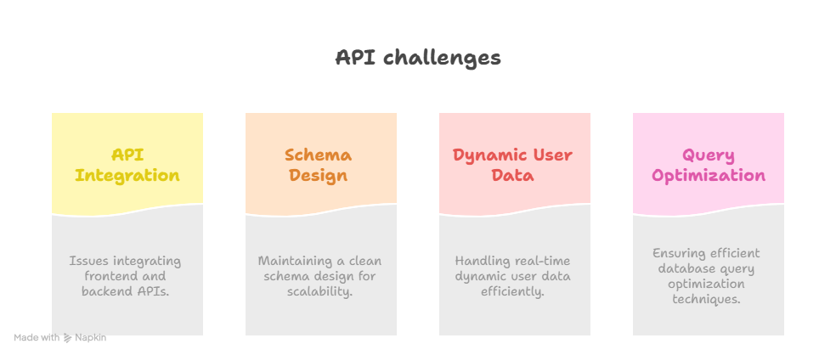




Step into fitblast and start your journey to strength, health, and confidence!
Challenges

Slide 11


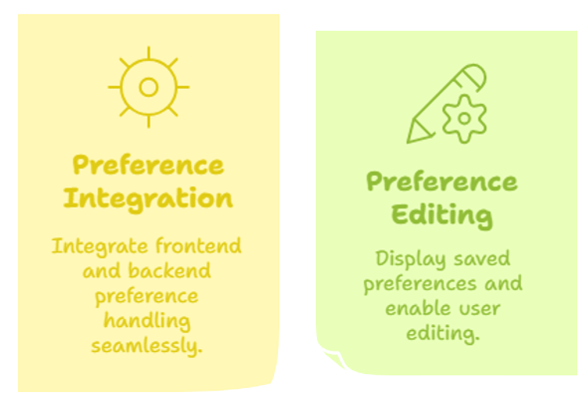
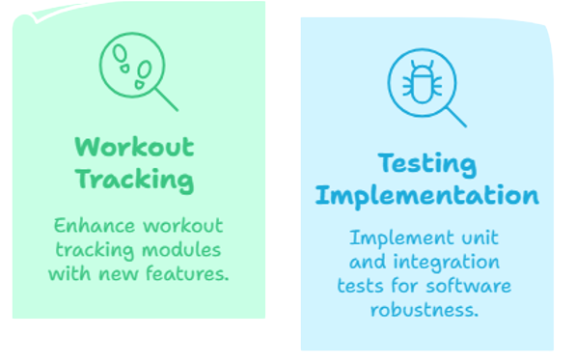

NEXT STEP

Slide 12



CONCLUSION
FitBlast is evolving into a full-featured fitness and social platform.
Backend is solid; focus shifts to frontend and scalability.
Future-ready with secure auth, structured DB, and modular design.

Slide 13




THANK YOU!
Join FITBLAST and start building a healthier, stronger, and more confident you!
info@fitblast.com
+91 9811843373
The Northcap University, Sector 23A, Gurugram

